Slide 1
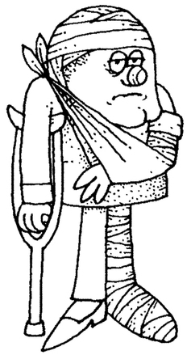
The who and where of insurance coverage at the DRFZ

Slide 2

The insurance company of the DRFZ is the „ Workers compensation board for health service and puplic welfare (BGW)“ [ Berufsgenossenschaft für Gesundheitsdienst und Wohlfahrtspflege]
Common
Keep that in mind for the accident insurance consultant
All those who have a contract at the DRFZ are covered .

Slide 3
What is a work related accident?: An accident that occurs inside the DRFZ/MPI building or on the direct way to work and back, but also on the way to the Mensa and back.
When must an accident notification
form must be filled out?:
Any injury requiring a visit to the drop off centre/ emergency room of the Charité. Any kind of injuries/accident must be written down in the first aid book.
Who is the accident insurance
consultant doctor?:
The Charité emergency room/ drop off centre.
Philippstraße 12, 10117 Berlin
Who does the ongoing examinations?:
Any doctor off your choice.
Where can I find the notification form?:
On the intranet under Job safety/ Arbeitsunfall or at the personnel office, where the form must be turned in.

Slide 4
Who must be informed about
my accident?:
The labor protection law states (§5 Abs.1 EFZG ), that any employee who are unable to work because of illness or injury must tell the employer (at the DRFZ it‘s the personnel office), usually on the first day of absence. You also have to turn in the examination form from the doctor.

Slide 5
Company outings / short business trips:
When am I covered?:
Company outings must be authorized by the company directors, otherwise they are not covered. Short business trips during working hours must be written down in the exit book, located at the reception at Mr. Höhn.
Where does my coverage start and end?:
The direct way back and forth –of your business trip, or of your official company outing.
What else should be aware of ?:
When you do somrthing alternative to the official company outing programm, or when you leave the locationy you are no longer covered.

Slide 6
Still some questions left?
Please call us:
Herr H. Schnurre (Personalangelegenheiten): -613
Herr R. Günther (FASI): -722

