Slide 1
Waste disposal in a nutshell For biological and genetic material of risk group 1, and for hazardous substances

Slide 2
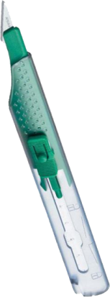
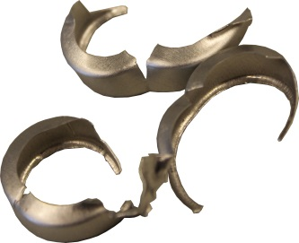

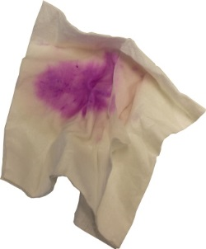

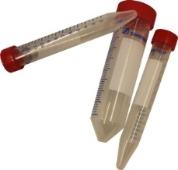

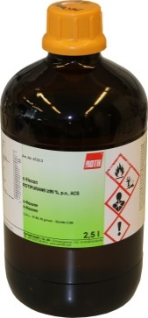

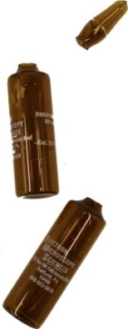


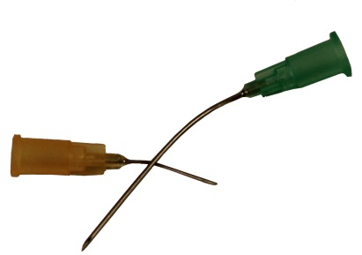

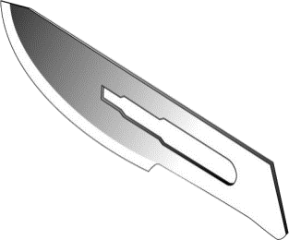

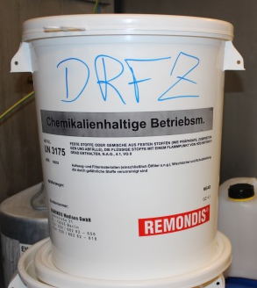
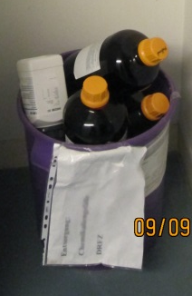
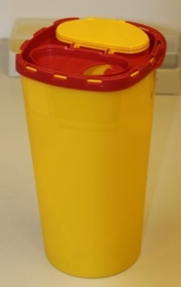
Put emptied bottles of hazardous substances
which are stamped with hazardous material symbols into to the purple bucket.
Operating materials contaminated with hazardous substances such as cloths, tubes, hoses, etc.
Especially equipment contaminated with phenol (pipette tips etc.)
Sharp objects such as scalpels, metal closures, cannulas etc.
2nd Floor:
between rooms 2.27 and 2.26
Basement room: 01.27
3rd floor:
Metal cabinets

Slide 3
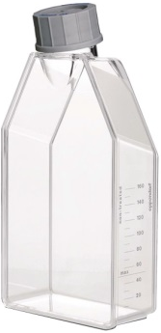
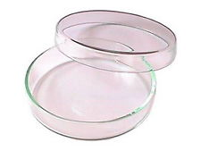

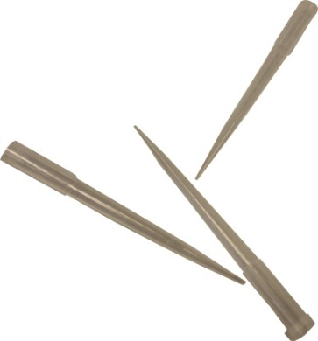


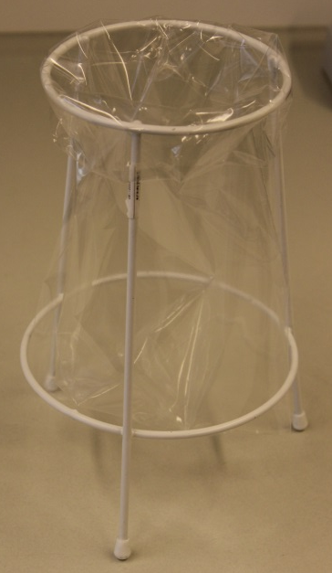
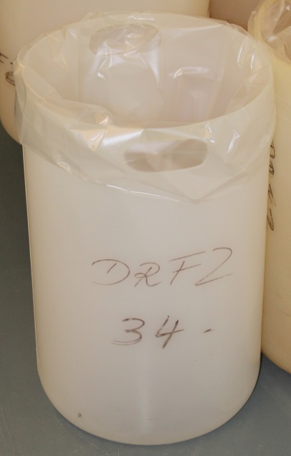
Items like: Pipette tips, Eppendorf tubes, 50ml tubes, etc., which are contaminated with risk group 1 material
Items like: Cell culture flasks, tubes, gloves etc. contaminated with risk group 1 material

Slide 4
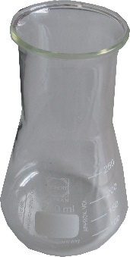
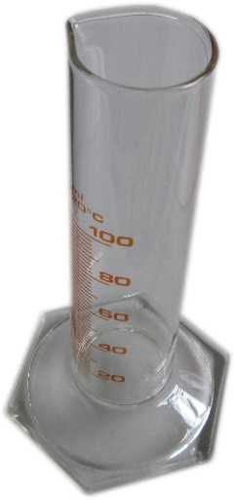
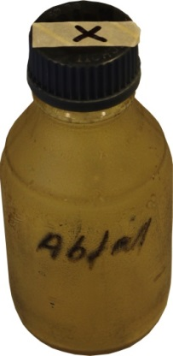
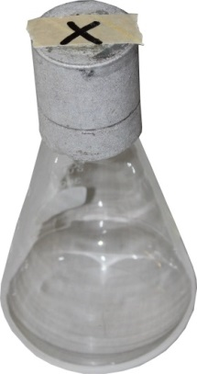
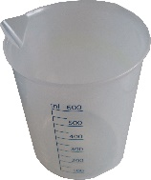
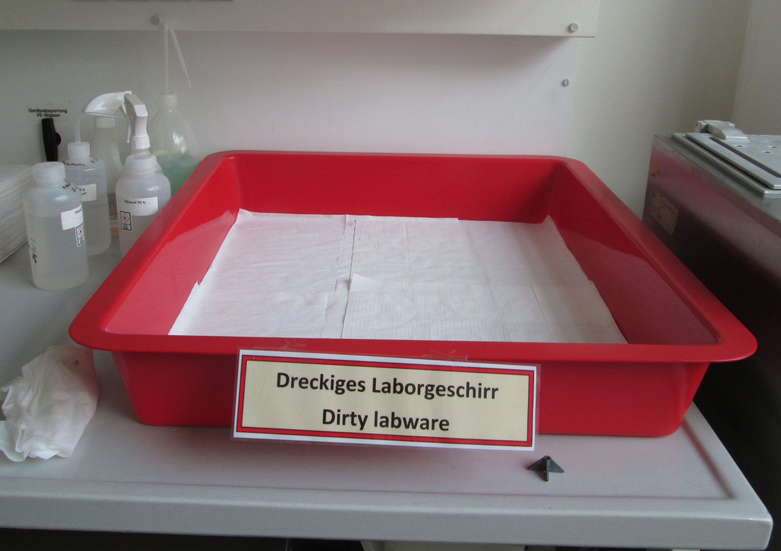
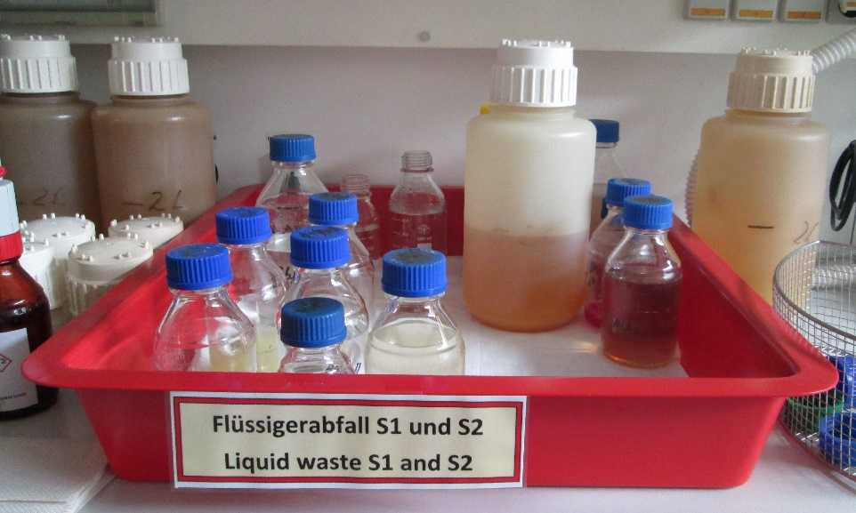
Labware that only needs to be rinsed and is not contaminated with materials of a risk group, such as beakers, empty PBS bottles, graduated cylinders, Erlenmeyer flasks, etc., are placed in the scullery in the tray for "Dirty labware".
Liquid waste contaminated with cells or bacteria of risk group 1 is marked with autoclave tape and a cross and placed in the scullery in the tray for " Liquid waste". This also applies to emptied vessels.

Slide 5
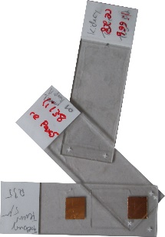
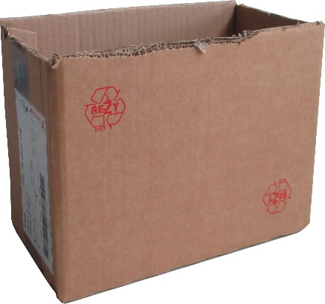
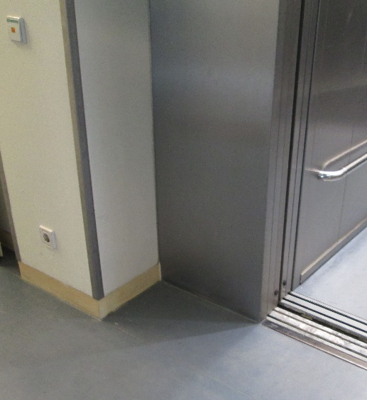
Microscope slides and cover slips contaminated with tissue sections of risk group 1 (mouse tissue) are disposed of via burn waste (B waste).For this purpose, the slides are collected in a cut-resistant container (e.g., rigid cardboard box) and placed in front of the elevator.
Cut resistant container
(No bags)

Slide 6
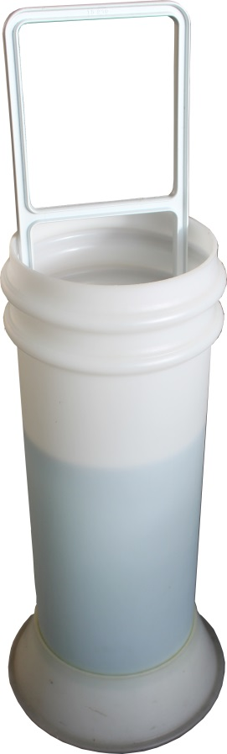
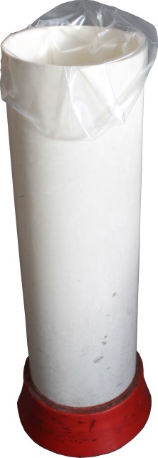
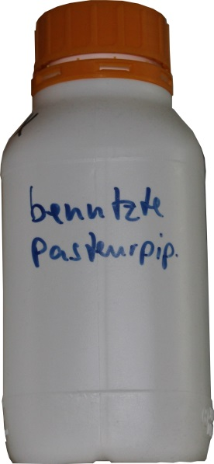
Glass pipettes belong into a Sekusept-aktiv solution
Plastic disposable pipettes into the pipette barrel
Pasteur glass pipettes into the provided canisters. Available in room 2.22.

Slide 7
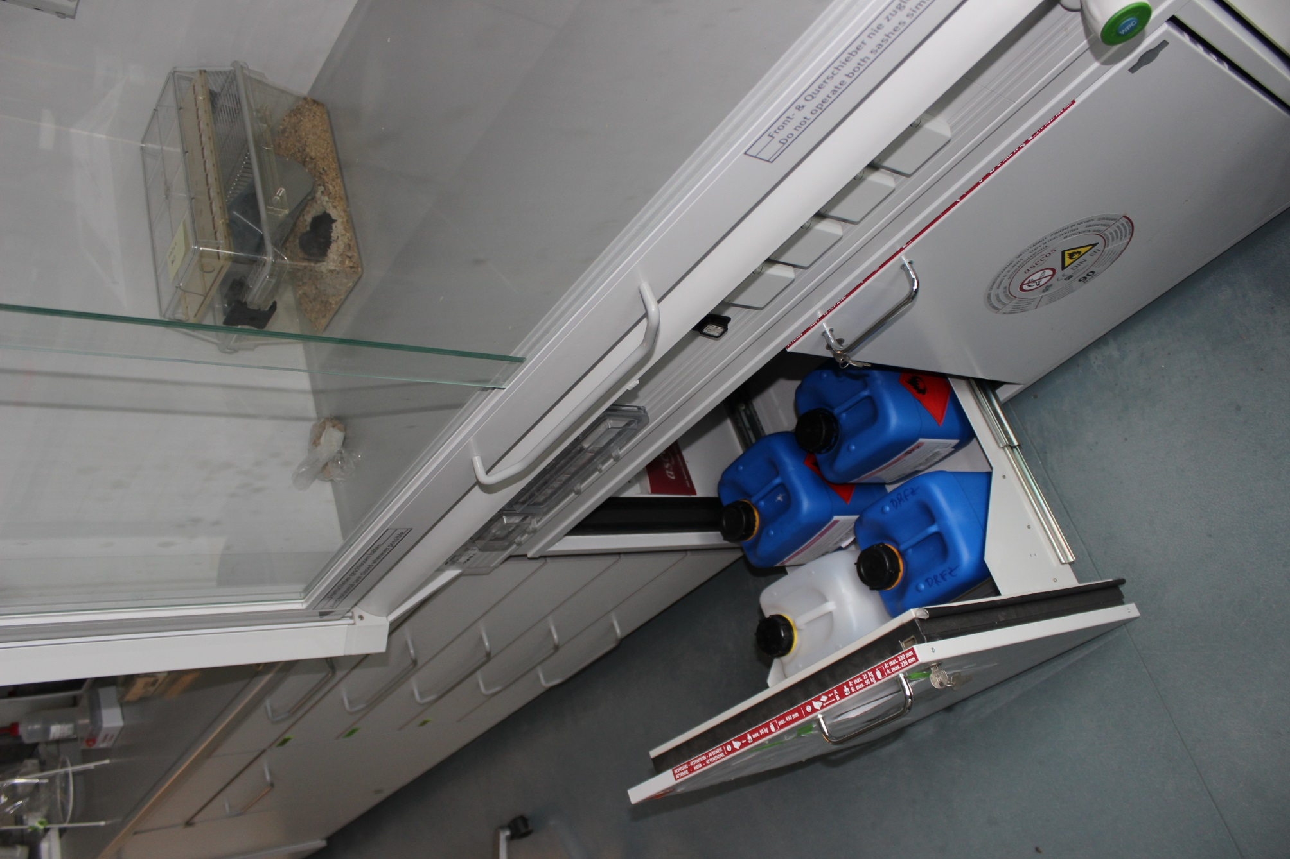
Liquid hazardous substances and their mixtures
Solvent halogen free:
All halogen-free solvents like ethanol, methanol, xylene, phenol.
Solvents halogenated:
All halogenated solvents like chloroform, dichloromethane, carbon tetrachloride and their mixtures.
Staining solutions
All aqueous dye solutions such as Giemsa, Fuchsin solutions and solvent mixtures containing ethidium bromide
Paraformaldehyde solutions:
All formaldehyde solutions of all concentrations.
Room: 0.02 or basement: 01.27

Slide 8
Special regulation for biological material of the
Risk group 2 and 3**

Slide 9
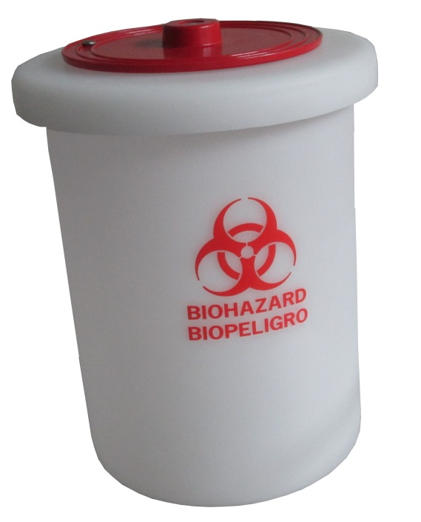
Plastic disposable pipettes are placed in the lockable
Pipette bin.
Pasteur glass pipettes belong in the provided canisters with lid available in room 2.22.
The full barrel is transported to the skullery 2.29/30.; then the inner bag with the pipettes is transferred to an autoclave barrel for S2.
Afterwards, the barrel is loaded again with a new bag, so that there are again two bags in the barrel. If both bags are contaminated, please transfer them both to the autoclaving barrel.

Slide 10
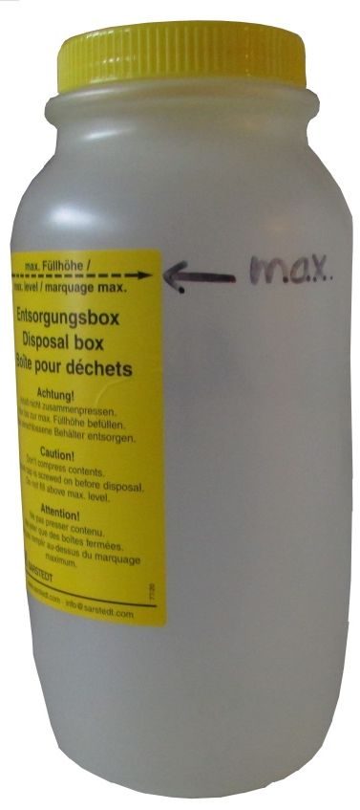
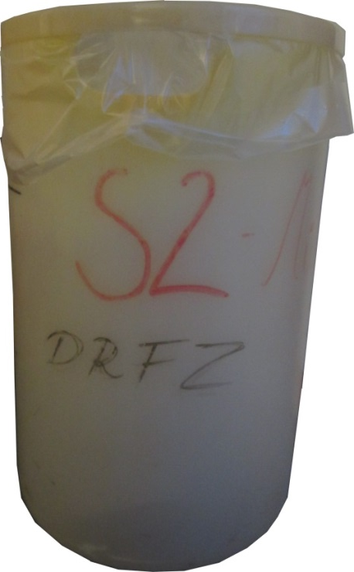
Solid waste contaminated with risk group 2 and 3** materials, such as cell culture flasks, tubes, gloves, etc. belongs into a autoclave bin where “S2” is written on.
Liquid waste contaminated with risk group 2 and 3** materials, such as blood, supernatants, urine, saliva, etc.
Maximum filling quantity
!
Must always be closed with a lid.

Slide 11
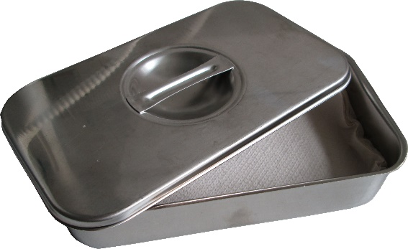
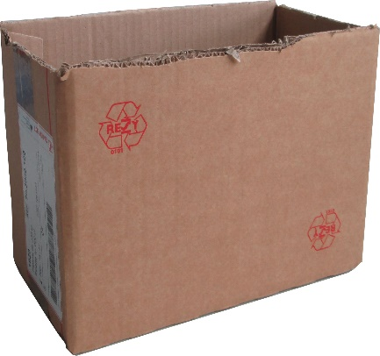
Autoclaving at 121°C
Microscope slides and cover slips contaminated with materials of risk group 2 or 3** (human material) must be autoclaved at 121°C beforehand. For this purpose, they are collected in a metal instrument tray and placed in the skullery. Empty instrument trays can also be found in the skullery.
After autoclaving, the slides are disposed of as shown on slide 5.

Slide 12
General rule:
Biological and genetic material waste of risk group 2, must be stored and transported in tightly closed, leak-proof and unbreakable containers.

Slide 13
Still questions
Robert Günther
Room 2.02. , phone: -722

